Slide 1
Chapter 5 Intermediate Representations I

Slide 2
Where In The Course Are We?
We are on the cusp of the art, science, & engineering of compilation
Scanning & parsing are applications of automata theory
The mid-section of the course will focus on issues where the compiler writer needs to choose among alternatives
The choices matter; they affect the quality of compiled code
There may be no “best answer” or “best practice”

Slide 3
Intermediate Representations
source
code
Front End
IR
Optimizer
IR
Back End
target
code
Front End emits IR for the rest of the compiler to use
Scanner & parser work from the syntax of the source code
Parser emits IR
Rest of the compiler works from IR
Analyzes IR to learn about the code
Transforms IR to improve final code
IR determines what a compiler can do to the code
Can only manipulate details that are represented in the IR
Front End
Parser
IR
annotations
stream of
tokens
syntax
stream of
characters
Scanner
microsyntax
Semantic Elaboration

Slide 4
Intermediate Representations
Front End
Optimizer
Back End
source
code
IR
…
IR
target
code
IR is the vehicle that carries information between phases
Front end: produces an intermediate representation (IR)
Optimizer: transforms the IR into an equivalent IR that runs faster
Each “pass” reads and writes IR
Back end: transforms the IR into native code
IR determines the compiler’s ambition & its chances for success
The compiler’s knowledge of the code is encoded in the IR
The compiler can only manipulate what is represented by the IR

Slide 5
Intermediate Representations
Decisions in IR design affect the speed and efficiency of the compiler
Some important IR properties
Ease of generation
Ease of manipulation
Procedure size
Expressiveness
Level of abstraction
The importance of different properties varies between compilers
Selecting an appropriate IR for a compiler is critical
Example
Expressiveness: a compiler with a near-source level IR may have trouble representing the results of some optimization.
The implementation of operator strength reduction (OSR) can only produce this result if the IR can represent *p++. (§ 10.7.2 in EaC2e.)
for i = 0 to n
for j = 0 to m
a[i,j] = 0
p = &a[0,0]
for i = 0 to n * m
*p++ = 0
Simple initialization
After OSR
Notes:
Operator strength reduction is a transformation that replaces a repeated series of expensive/strong operations with a series of inexpensive/weak operations that compute the same value.

Slide 6
Taxonomy of Intermediate Representations
We will organize our discussion of IRs along three axes:
structural organization
level of abstraction
naming discipline

Slide 7
IRs: Structural organization
Graphical
Heavily used in source-to-source translators
Tend to be large
Linear
Pseudo-code for an abstract machine
Level of abstraction varies
Simple, compact data structures
Easier to rearrange
An assembly language program is a form of linear code
Hybrid
Combination of graphs and linear code
Examples:
parse tree , AST, DAG, control flow graph, Call graph, dependence graph,
Examples:
3 address code
Stack machine code

Slide 8
Graphical IRs: Syntax Related Trees
An abstract syntax tree is a parse tree with the nodes for most non-terminal nodes removed
The AST is a near-source-level representation. Because of its rough correspondence to a parse tree, the parser can built an AST directly
Can use a linearized form of the tree
Easier to manipulate than pointers
x 2 y * - in postfix form
- X * 2 y in prefix form
G
-
E
Some compilers build an AST as an initial IR.
In practice, ASTs tend to be large — not because they must, but they grow.
E
-
T
x
*
T
T
*
F
2
y
AST for x – 2 * y
F
F
<id,y>
<id,x>
<num,2>
parse tree

Slide 9
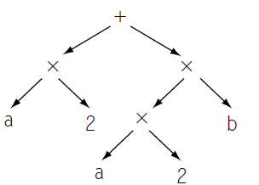
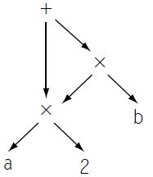
Graphical IRs: Syntax Related Trees
While the AST is more concise than a syntax tree, it faithfully retains the structure of the original source code.
AST for a × 2 + a × 2 × b:
A directed acyclic graph (DAG) is a contraction of the AST that avoids this duplication.
Two distinct copies of the expression a × 2.

Slide 10
Graphical IRs: Directed Acyclic Graph
A directed acyclic graph (DAG) is an AST with a unique node for each value. Identical subtrees are instantiated once, with multiple parents
Makes sharing explicit
Encodes redundancy
If the compiler uses graphical IRs, a DAG is a natural way to represent redundancy.
←
←
z
-
w
/
x
*
2
y
z ← x - 2 * y
w ← x / 2
With two copies of the same expression, the compiler may be able to arrange the code to evaluate it only once.

Slide 11
Graphical IRs: Control-flow Graph
Models the transfer of control in the procedure
Nodes in the graph are basic blocks
A directed graph
Edges in the graph represent control flow
Example
if (x = y)
Basic blocks: Maximal length sequences of straightline code
a ← 2
b ← 5
a ← 3
b ← 4
c ← a * b
Edges represent the branches & jumps at the ends of blocks.

Slide 12
Linear IRs: Stack Machine Code
Originally used for stack-based computers, now Java
Example:
x - 2 * y becomes
Advantages
Compact form
Introduced names are implicit, not explicit
Simple to generate and execute code
Useful where code is transmitted over slow communication links or where memory is limited
Java bytecode was designed for transmission over slow links
push x
push 2
push y
multiply
subtract
Implicit names take up no space, where explicit ones do!

Slide 13
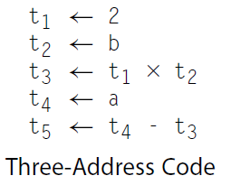
Linear IRs: Three Address Code
In general, three address code has statements of the form:
x ← y op z
With 1 operator (op ) and, at most, 3 names (x, y, & z)
Example:
a - 2 × b becomes
Advantages:
Reasonably compact form
Resembles many real machines
Introduces a new set of names, a carefully chosen name space can reveal new opportunities to improve the code

Slide 14
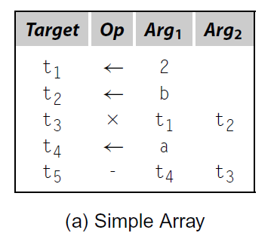
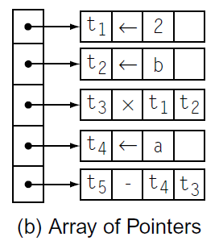
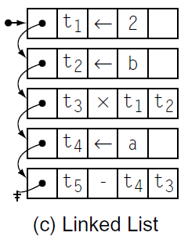
Linear IRs: Representation of Three Address Code
Three-address codes are often implemented as a set of quadruples.
To form blocks, the compiler needs a mechanism to connect individual quadruples.
Compilers implement quadruples in a variety of ways.

Slide 15
Linear IRs: Three Address Code- Quadruples
a- 2 * b: lower level code
The original FORTRAN compiler used “quads”
loadI | 1 | 2
load | 2 | b
mult | 3 | 2 | 1
load | 4 | a
sub | 5 | 4 | 3
loadI r1, 2
load r2, b
mult r3, r2, r1
load r4, a
sub r5, r4, r3
RISC assembly code
Quadruples

Slide 16
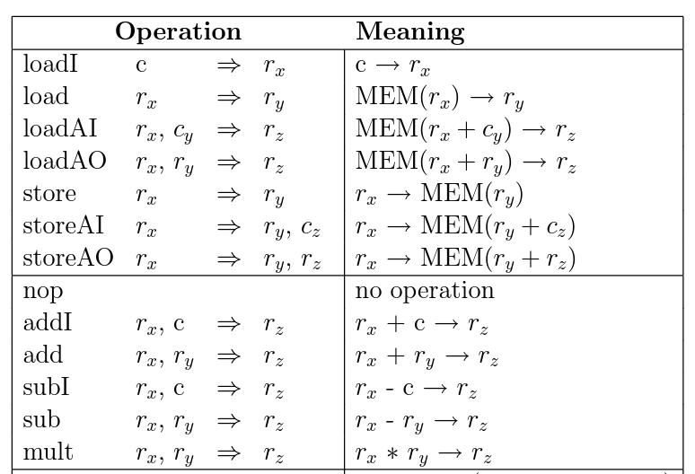
ILOC Instruction Set (Appendix A)
ILOC is the assembly code for a simple abstract machine that has an unlimited number of registers.

Slide 17
Linear IRs: Three Address Code- Triples
Index used as implicit name
25% less space consumed than quads
Much harder to reorder
Remember, for a long time, 640KB was a lot of RAM
(1) | loadI | 2
(2) | load | y
(3) | mult | (1) | (2)
(4) | load | x
(5) | sub | (4) | (3)
loadI r1, 2
loadI r2, y
mult r3, r2, r1
load r4, x
sub r5, r4, r3
Implicit names occupy no space

Slide 18
Linear IRs: Two Address Code
Allows statements of the form
x ← x op y
Has 1 operator (op ) and, at most, 2 names (x and y)
Example:
a- 2 * b becomes
Can be very compact
Problems
Difficult name space
Destructive operations (an operation in which one of the operands is always redefined with the result) make reuse hard
Good model for machines with destructive ops (PDP-11, x86)
We would like destructive operations to become a thing of the past
t₁ ← 2
t₂ ← load b
t₂ ← t₂ * t₁
z ← load a
z ← z - t₂
Not many arguments in favor of two-address code

Slide 19
Hybrid IRs: Combination of IRs
Often compilers use a CFG to represent control flow and a linear IR to represent code in blocks
This hybrid IR with the advantages of a graph
Easy navigation between blocks
And the advantages of a linear IR
Explicit, low-level detail & operation sequence
Strengths
Good for understanding control-flow issues
Reasonably good for instruction scheduling

Slide 20
IRs: Level of Abstraction
The level of detail exposed in an IR influences the profitability and feasibility of different optimizations.
Two different representations of an array reference, A is a 10X10 array:
loadI 1 => r₁
sub r_{i}, r₁ => r₂
loadI 10 => r₃
mult r₂, r₃ => r₄
sub r_{j}, r₁ => r₅
add r₄, r₅ => r₆
loadI @A => r₇
add r₇, r₆ => r₈
load r₈ => r_{Aij}
subscript
@A + 10 *(i-1)+ (j-1)
A
i
j
High level Abstract Syntax Tree (AST): easy to find and compare
References
Low level linear code:
Good for address calculation and
optimizing the target-machine code

Slide 21
IRs: Level of Abstraction
Structural IRs are usually considered high-level
Linear IRs are usually considered low-level
Not necessarily true:
load
Low level AST
loadArray A,i,j
+
High-level linear code
+
@A
*
-
-
10
j
1
i
1

Slide 22
Using Multiple Representations
Front End
Optimizer
Optimizer
Back End
source
code
IR₁
…
IR₂
…
IR₃
target
code
Repeatedly lower the level of the intermediate representation
Each intermediate representation is suited towards certain optimizations
Example: the Open64 compiler
WHIRL intermediate format
Consists of 5 different IRs that are progressively more detailed and less abstract
Each successive IR focuses on a different set of challenges & opportunities
Translation is a monotonic lowering of level of abstraction
Compilers are good at lowering level of abstraction & not so good at raising it

Slide 23
MAPPING VALUES TO NAMES
The compiler must invent names for many, if not all, of the intermediate results that the program produces when it executes.
The choices that it makes with regard to names determines, to a large extent, which computations can be analyzed and optimized.

Slide 24
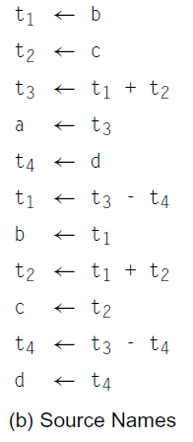
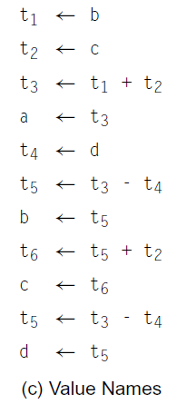
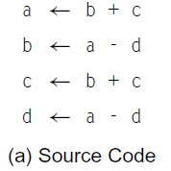
Naming Temporary Values
Naming Leads to Different Translations

Slide 25
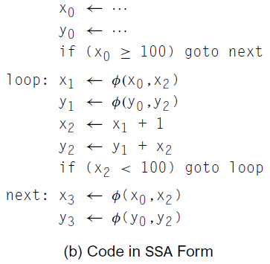
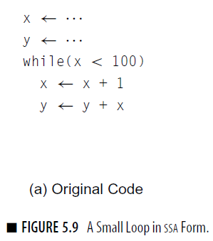
Static Single-Assignment (SSA) Form
A naming discipline that many modern compilers use to encode information about both the flow of control and the flow of data values in the program (See 9.3).
Names correspond uniquely to specific definition points in the code; each name is defined by one operation, hence the name static single assignment.
SSA form inserts φ-functions at merge points to reconcile name space: φ -function takes several names and merges them, defining a new name.
SSA form was intended for code optimization.
φ-function
behavior depends on context
takes an arbitrary number of operands
do not conform to a three-address model
compiler writer must include a mechanism for representing operations with longer operand list

Slide 26
Memory Models
The compiler must determine, for each value computed in the code, where that value will reside.
An IR usually incorporates a memory model, either explicitly or implicitly.
Register-to-register model
Keep all values that can legally be stored in a register in registers
Ignore machine limitations on number of registers
Compiler back-end must insert loads and stores
Memory-to-memory model
Keep all values in memory
Only promote values to registers directly before they are used
Compiler back-end can remove loads and stores

Slide 27
The Rest of the Story…
Representing the code is only part of an IR
There are other necessary components
Symbol table
Constant table
Representation, type
Storage class, offset
Storage map
Overall storage layout
Overlap information
Virtual register assignments

Slide 28
A Compiler’s Symbol Table
Table has an entry for every name that the compiler knows
Variables, labels, procedures, classes, system calls, …
Entry for a name has a whole bunch of associated fields
Lexeme, storage class, type, address, length, declaring scope, …
Name
Type
Addr
Len
Sc
…
h(y)
y
int
0
4
local
x
char
8
0
static
The compiler can use y’s table index, h(y), as a short name for y
z
float
4
4
local

Slide 29
What Are The Issues?
The compiler needs
Compile-time mechanism for name resolution
Runtime mechanism to compute an address from a name
Compiler must emit code that builds & maintains the runtime structures for addressability
*

Slide 30
Symbol Tables
Classic approach to building a symbol table uses hashing
Better solution: a two-table scheme
Sparse index to reduce chance of collisions
Dense table to hold actual data
Easy to expand, to traverse, to read & write from/to files
Use chains in index to handle collisions
Collision occurs when h() returns a slot in the sparse index that is already full.
Stack-like growth
h(“foe”)
h(“fee”)
fum | float | scalar | …
NextSlot
fee | integer | scalar | …
fie | char * | array | …
Sparse index
Dense table

